Slide 1
SHOPPING MANAGEMENT SYSTEM
Submitted By
P.Dwarakanath Reddy
Under the Esteemed Guidance of
MRS. ANJANA SARODE
MASTER TRAINER
EDUBRIDGE

Slide 2
INTRODUCTION:
To develop a Shopping Management System where users can search for products, view a complete description of the products and order the products.
A search engine that provides an easy and convenient way to search for products specific to their needs.
The search engine would list a set of products based on the search term and the user can further filter the list based on various parameters.
The final result will be displayed on the screen.

Slide 3
WEB TECHNOLOGIES USED:
HTML
CSS
JAVA JSP
SQL

Slide 4
Introduction to web technologies:
HTML is used to structure a web page and its content.
CSS is used to define styles for our web pages.
JSP is used to create dynamic web content.
SQL is used to communicate with a database.

Slide 5
IMPLEMENTATION:
'
Shopping Management System
Signup
User
Admin
Login
Login
Search for Products
Add new Product
Edit Products
Orders Received
Cancel Orders
Delivered Orders
Add to cart
Order Product
Logout
Login
Logout

Slide 6
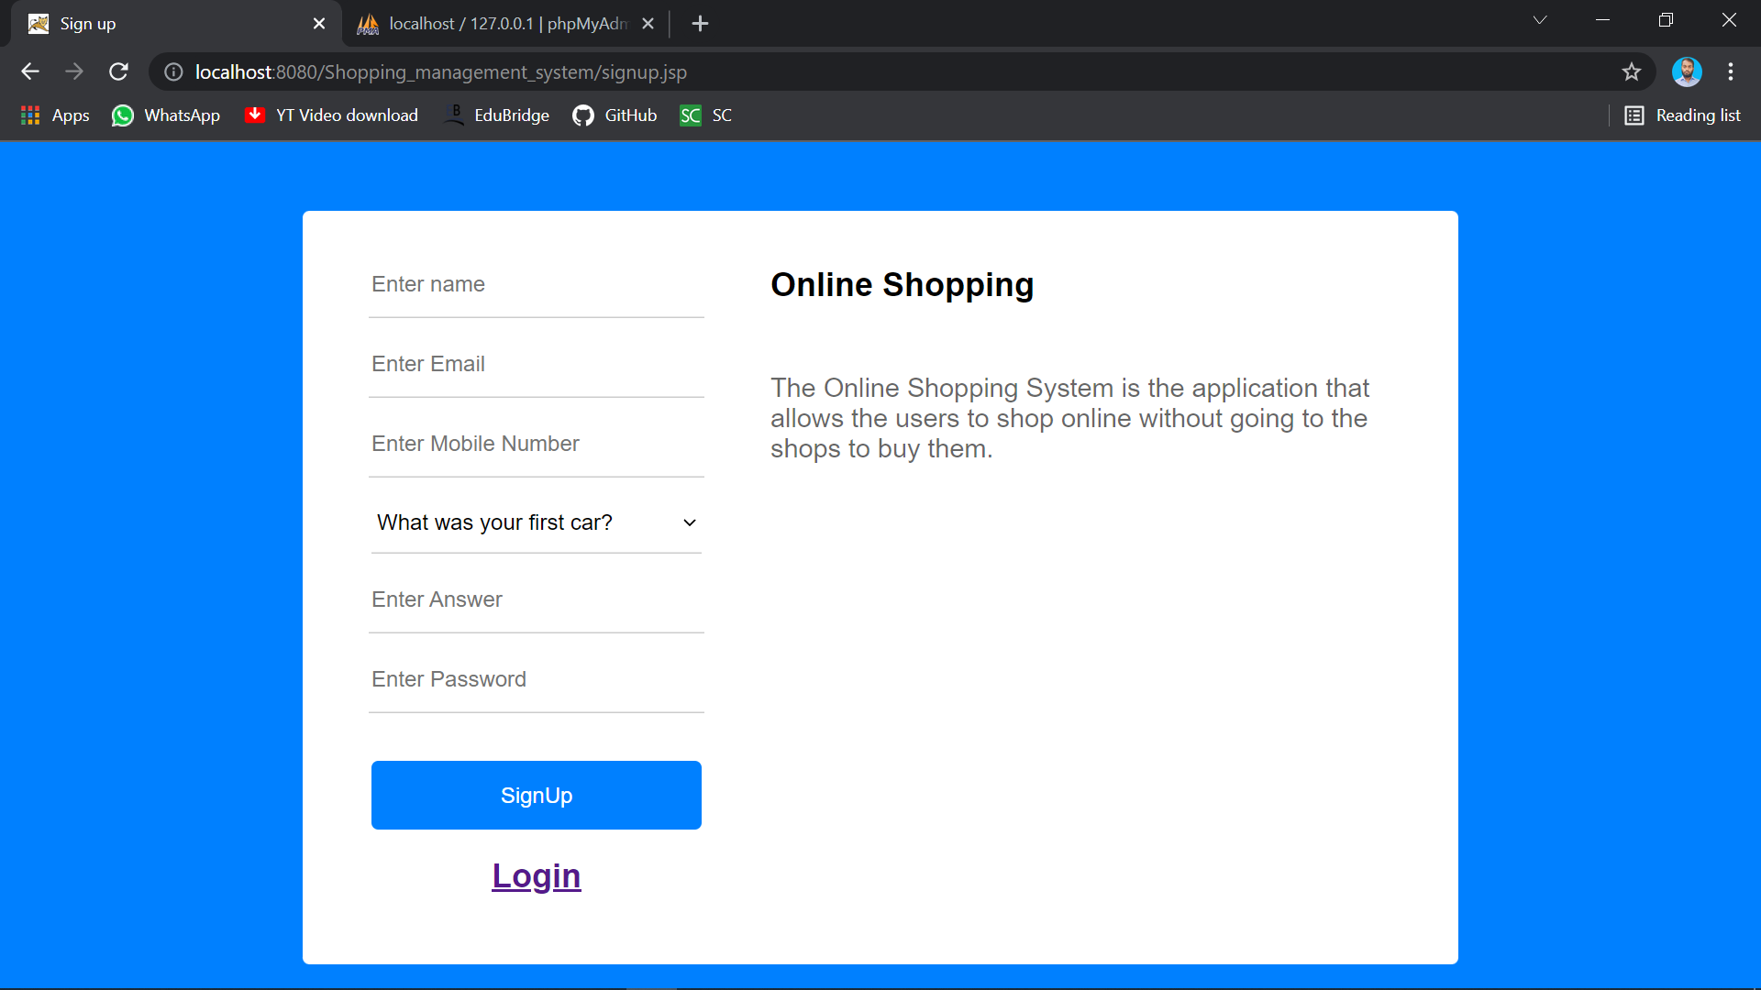
Signup-Page:

Slide 7
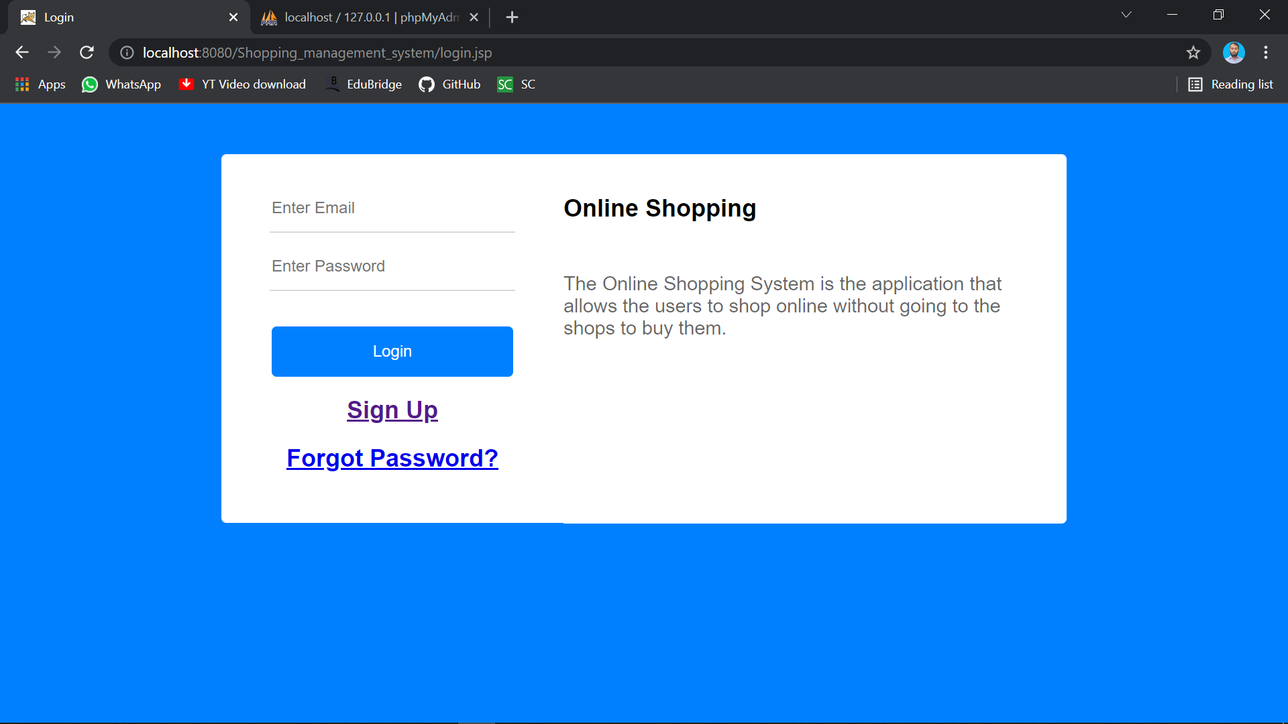
Login Page:

Slide 8
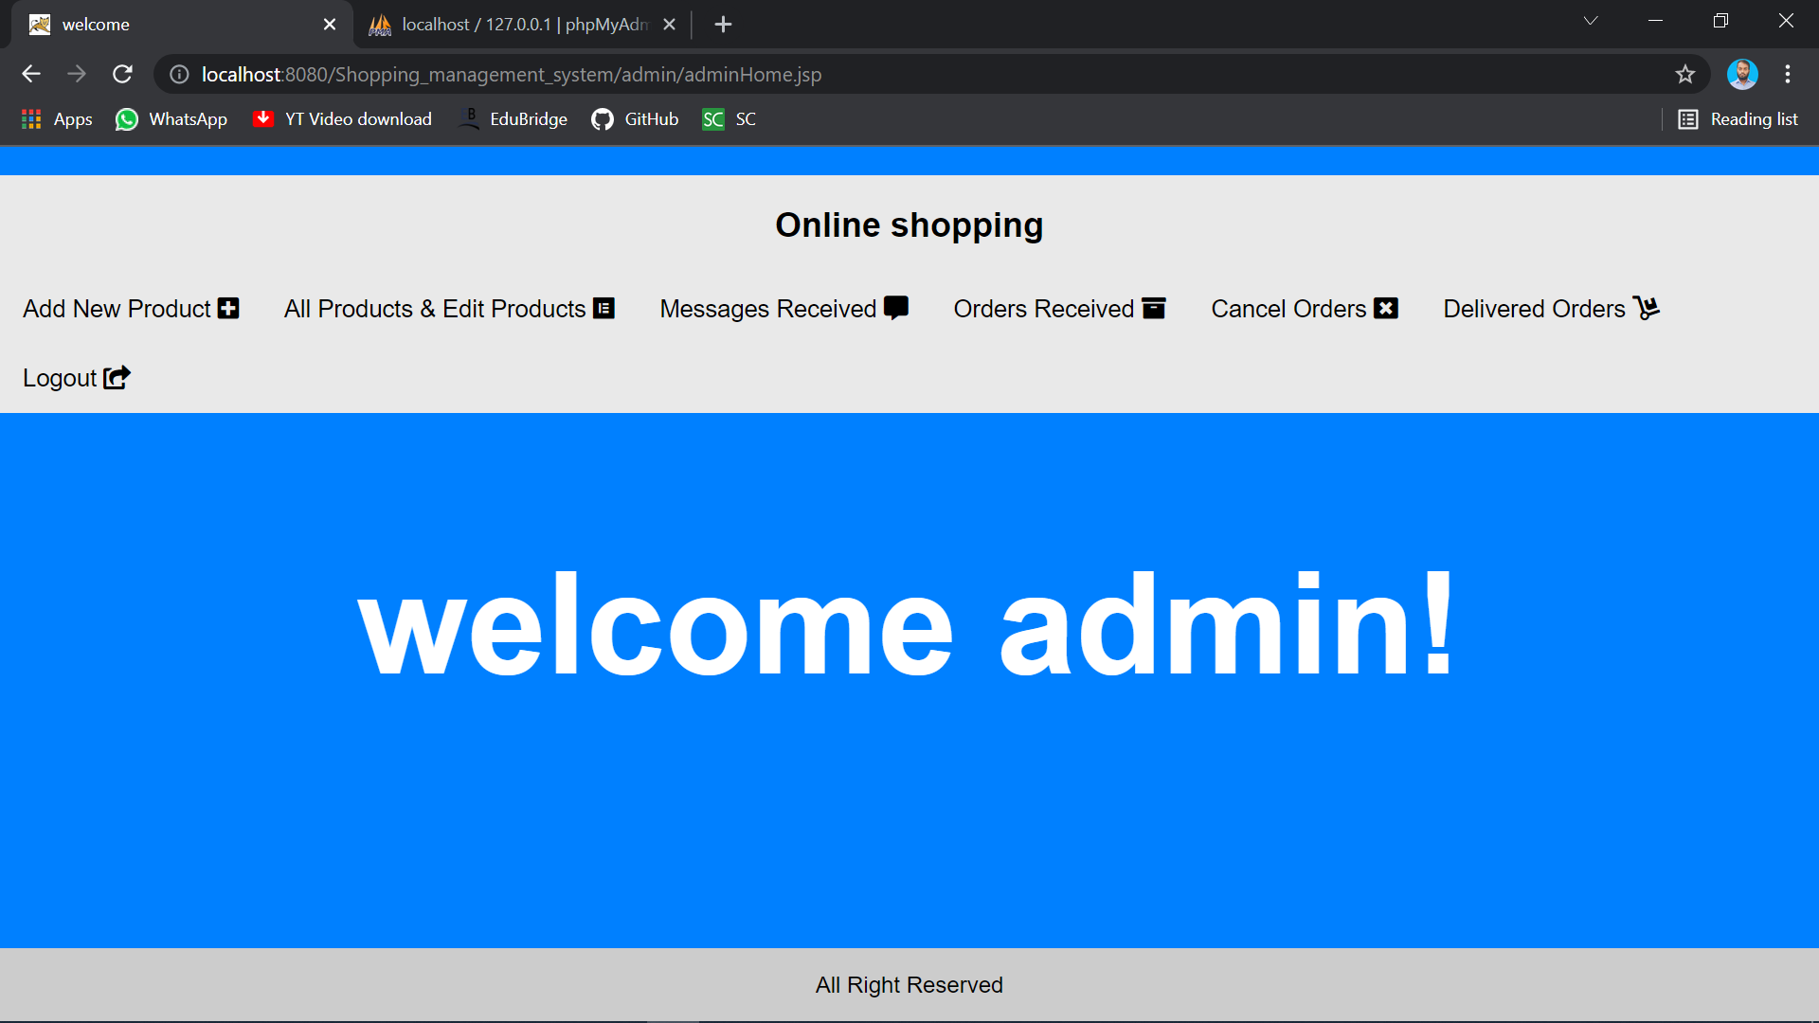
Admin Page:

Slide 9
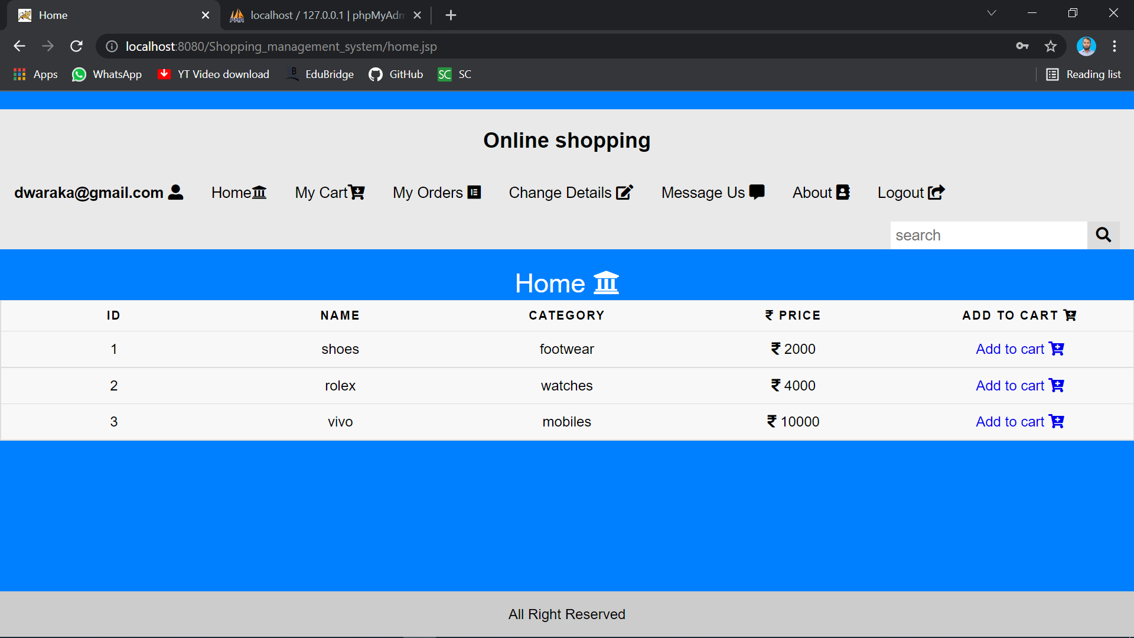
User Page:

Slide 10


